Slide 1
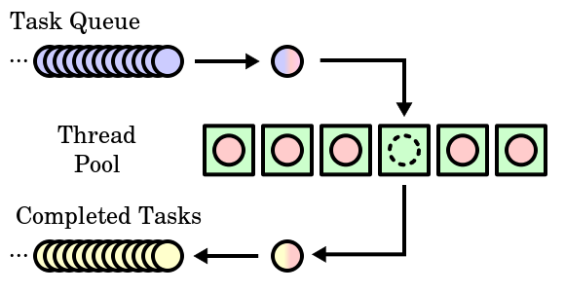
Java Thread Pool
A thread pool is a group of threads initially created that waits for jobs and executes them.
The idea is to have the threads always existing, so that we won't have to pay overhead time for creating them every time. They are appropriate when we know there's a stream of jobs to process, even though there could be some time when there are no jobs.
Thread pool consists of a number m of threads, created to perform a number n of tasks concurrently. Typically m is not equal to n; instead, the number of threads is tuned to the computing resources available to handle tasks in parallel (processors, cores, memory) while the number of tasks depends on the problem and may not be known upfront.
A sample thread pool (green boxes) with
waiting tasks (blue) and completed tasks (yellow)

Slide 2
Java Thread Pool
Reasons for using a thread pool, rather than the obvious alternative of spawning one thread per task, are to prevent the time and memory overhead inherent in thread creation and to avoid running out of resources such as open files or network connections (of which operating systems allocate a limited number to running programs).
A common way of distributing the tasks to threads (scheduling the tasks for execution) is by means of a synchronized queue known as a task queue. The threads in the pool take tasks off the queue, perform them, then return to the thread pool for their next task.
A major advantage of using a thread pool over creating a new thread for each task is that thread creation and destruction overhead is negated, which may result in better performance and better system stability. Creating and destroying a thread and its associated resources is an expensive process in terms of time. An excessive number of threads will also waste memory, and context-switching between the runnable threads also damages performance.

